Slide 1
Information and Thoughts Of The Families Who Have Applied To Bezmialem Vakıf University Pediatric Emergency Room and Pediatric Polyclinics About Childhood Vaccinations
ÇAĞLAR SERTKAYA
DOÇ.DR UFUK ERENBERK

Slide 2
What is a vaccine ? What are vaccines for ?
Vaccine is a substance used to stimulate the production of antibodies and provide immunity against one or several diseases, prepared from the causative agent of a disease, its products, or a synthetic substitute, treated to act as an antigen without inducing the disease.
Vaccines are made for prophylaxis in diseases caused by viruses and bacteria and they help the body develop an immune response against these diseases.

Slide 3
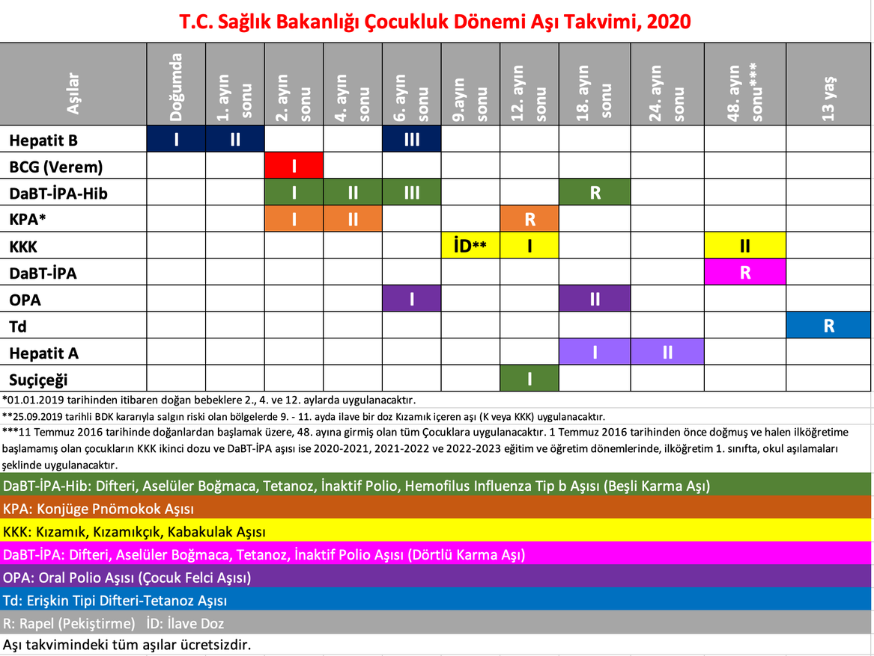
The childhood vaccination program implemented by the Ministry of Health includes many vaccines.
Vaccines included in this program are : Hepatitis B, BCG, DaBT-İPA-Hib, KPA, KKK, DaBT-İPA, OPA, Td, Hepatitis A and Chickenpox vaccines.

Slide 4
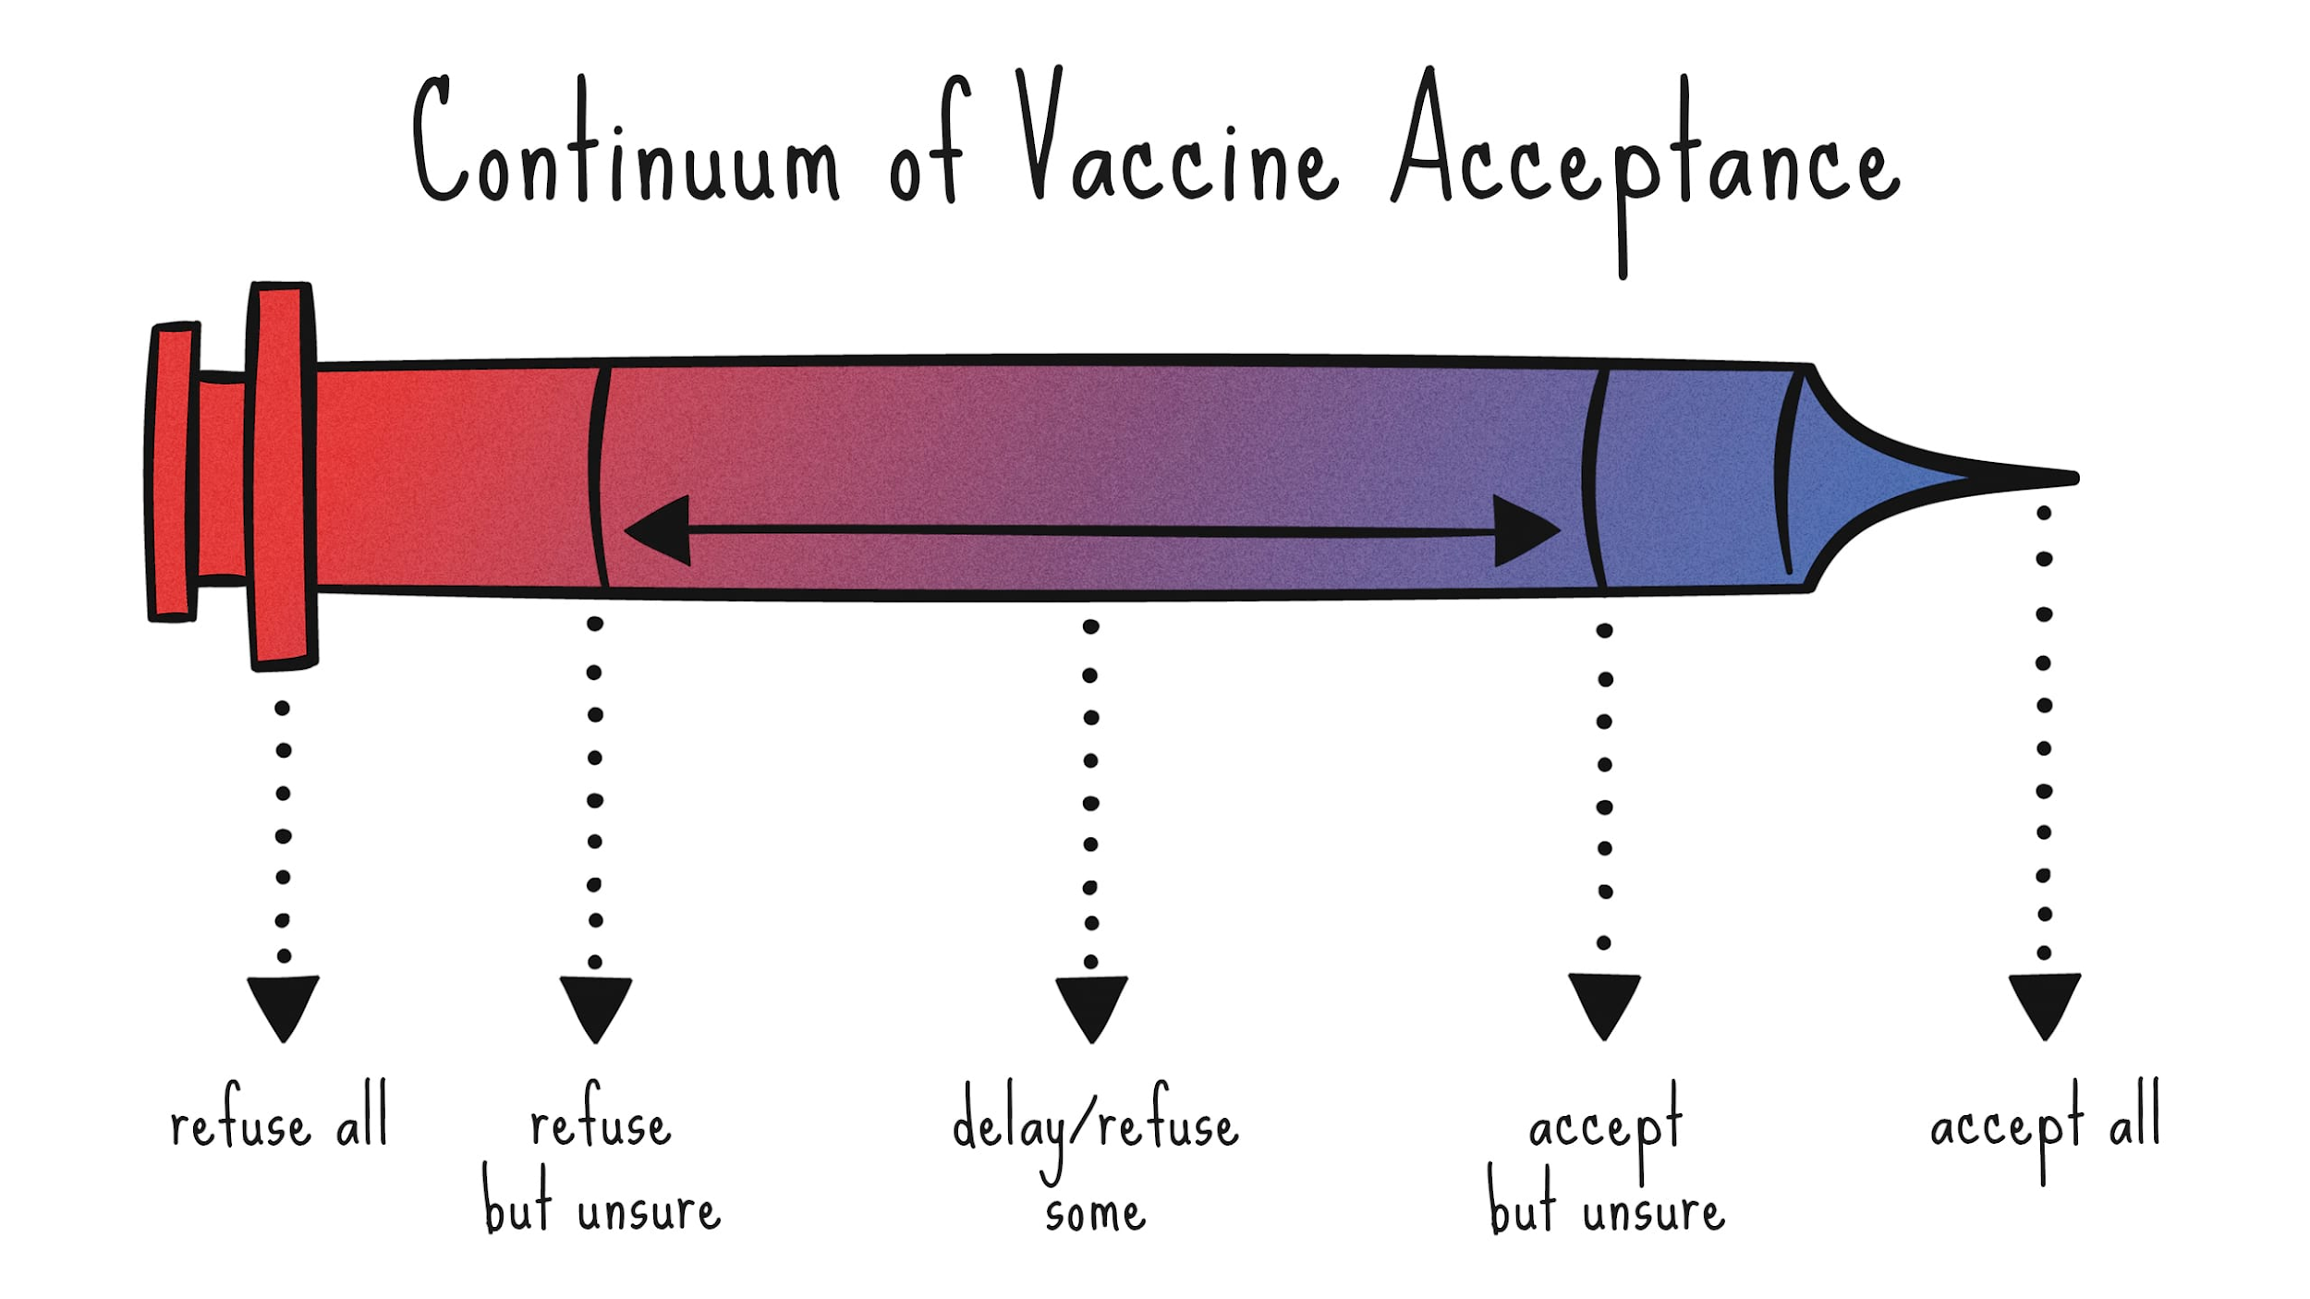
Vaccination opposition has led to a decrease in vaccine acceptance rates and an increase in vaccine-preventable disease outbreaks.
We planned to collect information about the awareness and opinions of the families who applied to the Pediatric Emergency Service and Pediatric Polyclinics of our hospital, and to investigate whether the patients who applied were vaccine opponents and the reasons.

Slide 5
Method
A 15-question questionnaire study was prepared using the literature to be applied to the families who applied to the Pediatric Emergency Service and Pediatric Polyclinics.
Chi-square test will be used for categorical test.Frequency analysis will be used for descriptive statistics
The sample size was set to 150.
Data will be analyzed in IBM SPSS Statistics 20.0 program.

Slide 6
1. Age:
2. Gender:
3. Education Status:
Primary School Secondary School High School University
4. Number of Children:
1 2 3 4 5 and above
5. I know what vaccines are for
No Partially Yes
6. Have you had your child vaccinated before?
Yes No
7. Do you know the Ministry of Health Childhood Vaccination Calendar?
Yes No
8. Do you regularly get the vaccinations in this calendar?
Yes No
9. Are there any mandatory vaccinations that you have not had?
Yes No

Slide 7
10. Do you know any paid vaccines that are not included in this Calendar?
Yes No
11. If you know, which of these vaccines have you had?
Rotavirus HPV Meningococcus
12. Are you opposed to vaccination ?
Yes Partially No
13. Where did you hear about the opposition to vaccination?
Television Social Media Social Environment Internet
14. What is the reason for your opposition to vaccination?
I don't think vaccines are helpful.
I think vaccines are harmful.
I think it causes Autism/Polio/Cancer etc.
I think vaccines contain harmful substances.
15. Do you know that the rate of social disease increases with insufficient vaccination against vaccine-preventable diseases?
Yes No

Slide 8
Results
70 of the participants are university graduates (47%), 31 of them are high school (20.8%), 28 of them are secondary school (18.8%), 20 of them are primary school graduates (13.4%).

Slide 9
68 of them know the paid vaccines that are not included in this Calendar (45.3%)
2-HPV
11-Meningococcus
17-Rotavirus
3-Rota+HPV
5-Rota+HPV+Meningococcus
22-Rota+Meningococcus
Rotavirus (78.3%)
HPV (16.6%)
Meningococcus (63.3%)
Television-8 (6.2%)
Social Media-28 (22%)
Social Environment-66 (51.9%)
Internet-25 (19.6%)

Slide 10
What is the reason for your opposition to vaccination?
I don't think vaccines are helpful.
6 (8.3%)
I think vaccines are harmful.
9 (12.5%)
I think it causes Autism/Polio/Cancer etc.
30(41.6%)
I think vaccines contain harmful substances.
27(37.5%)

Slide 11
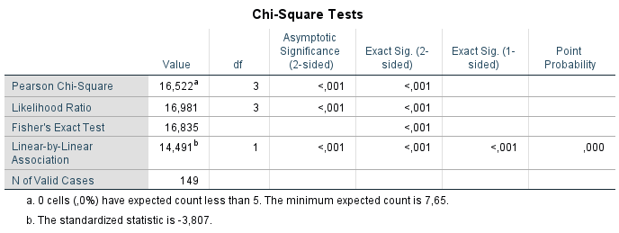
The 92 of the participants know the Ministry of Health Childhood Vaccination Schedule (61.7%).
Due to our data there is a strong connection between education level and knowledge of the vaccination Schedule (p=0.001).

Slide 12
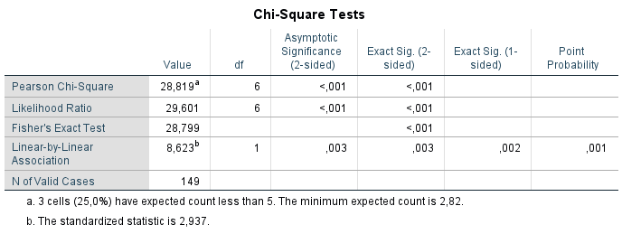
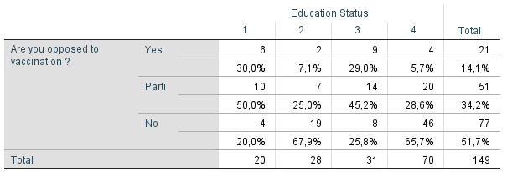
The 14.1% of participants are vaccine opponent, 34.2% partly and 51.7% were not vaccine opponents.
There is a significant relation between education level and vaccine opposition (p<0.001).

Slide 13
Conclusion
As a result of this study, it was found that there is a significant correlation between education level with knowledge of vaccine Schedule and vaccine opposition.

Slide 14
References
1.Koksal T, Akelma AZ, Koksal AO, Kutukoglu I, Ozdemir O, Yuksel CN, Bozkaya D, Catal F, Sari S. Cost-effectiveness of rotavirus vaccination in Turkey. J Microbiol Immunol Infect. 2017 Oct;50(5):693-699. doi:10.1016/j.jmii.2016.03.005.
2. Dubé E, Vivion M, MacDonald NE. Vaccine hesitancy, vaccine refusal and the anti-vaccine movement: influence, impact and implications. Expert Rev Vaccines. 2015 Jan;14(1):99-117. doi: 10.1586/14760584.2015.964212.
3. Hobson-West P. 'Trusting blindly can be the biggest risk of all': organised resistance to childhood vaccination in the UK. Sociol Health Illn. 2007 Mar;29(2):198-215.
4. Kieslich K. Addressing vaccination hesitancy in Europe: a case study in
state-society relations. Eur J Public Health. 2018 Nov 1;28(suppl_3):30-33. doi: 10.1093/eurpub/cky155.
5. Hussain A, Ali S, Ahmed M, Hussain S. The Anti-vaccination Movement: A
Regression in Modern Medicine. Cureus. 2018 Jul 3;10(7):e2919. doi:
10.7759/cureus.2919.

Slide 15
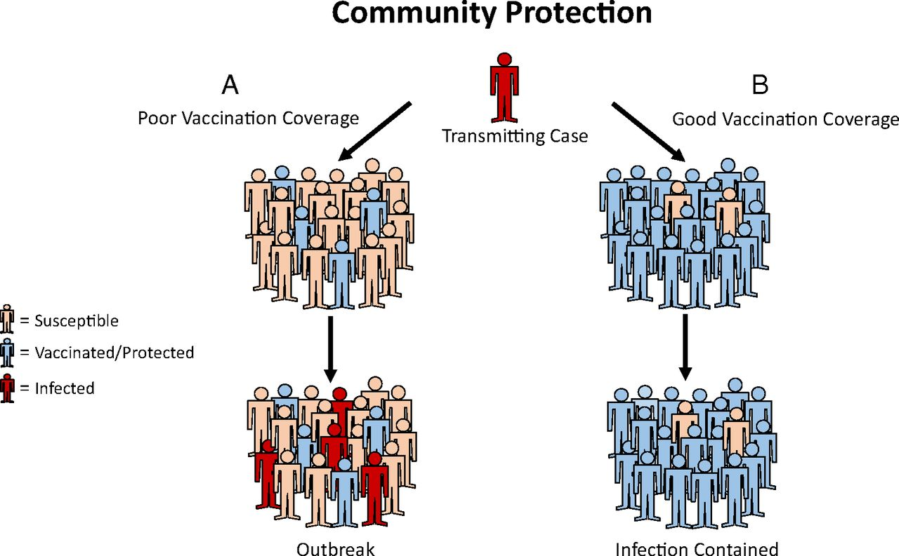
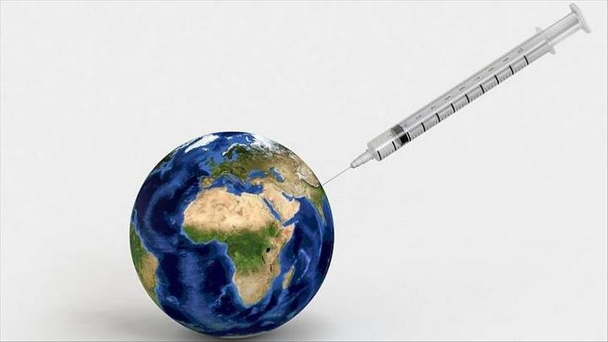
THANK YOU FOR YOUR PATİENCE

